Slide 1
English Writing II
Week 7 Readings

Slide 2
In today’s lesson
Reading for writing
Life on Lockdown in China by Peter Hessler
Responding to Covid-19 — A Once-in-a-Century Pandemic? by Bill Gates
The World after Coronavirus by Yuval Noah Harari

Slide 3
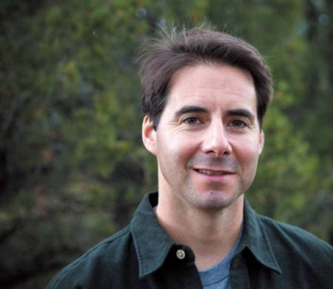
Peter Hessler (1969-)
Journalist and writer
Teacher
何伟

Slide 4

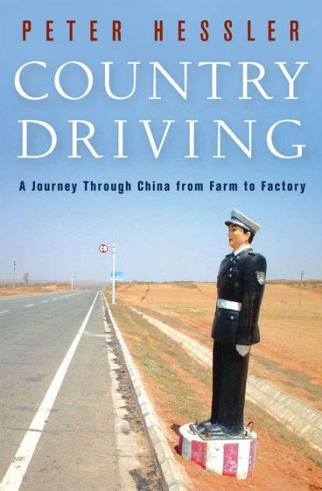
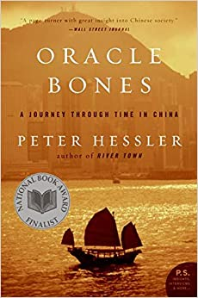


Slide 5
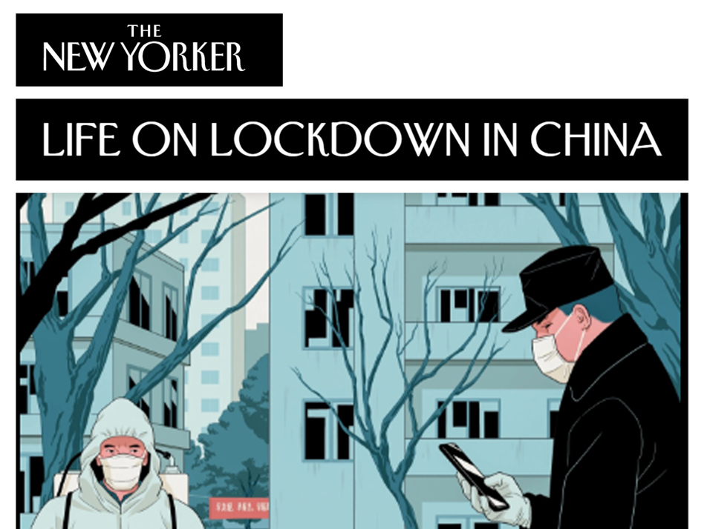
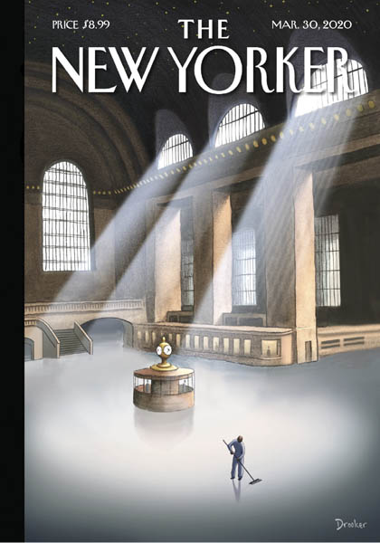

Slide 6
Excerpts 1
There were no greetings, no jokes, no moments of commiseration. Part of it was the masks, which were an obsession. On my floor, residents wore them even if they were merely dropping off garbage, ten feet from their door. Mask-wearing, after all, was required by the new measures, and people were diligent: I often saw motorcycle deliverymen helmetless and fiddling with their phones at thirty miles an hour, their masks safely in place.

Slide 7
Excerpt 2
At the restaurant, the hostess shot Ariel and Natasha with an infrared gun, and then Leslie and I took our turn. The hostess carried a clipboard on which we wrote our names, cellphone numbers, and temperatures: Ariel, 36.5; Natasha, 36.2; Leslie, 36.2; me, 36.0. We sat down and unmasked.

Slide 8
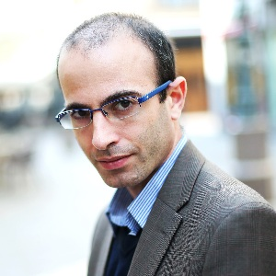
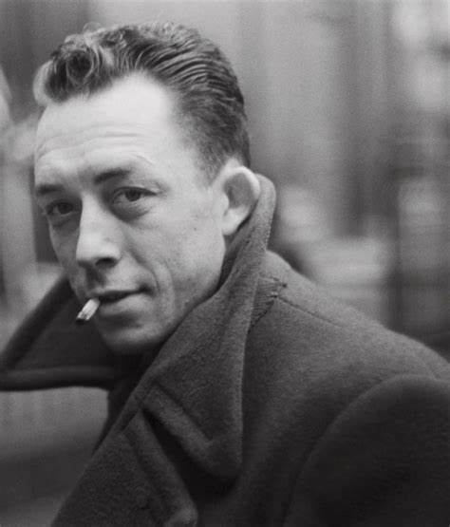
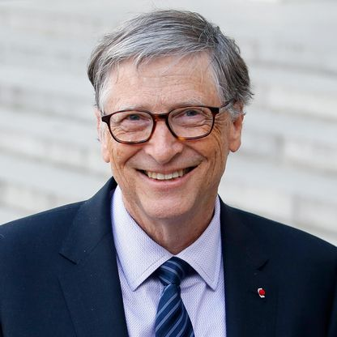
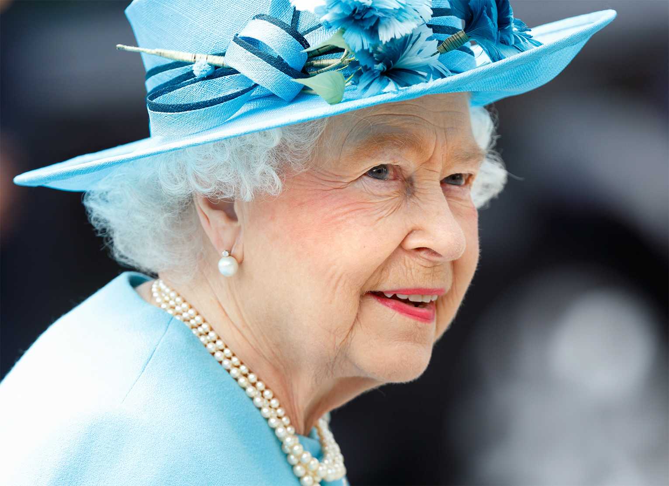
In-class reading

Slide 9
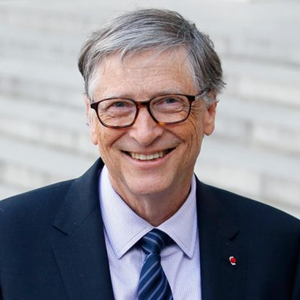
Bill Gates (2020)
Responding to Covid-19 — A Once-in-a-Century Pandemic?
New English Medical Journal (NEMJ）28th Feb. 2020
20-minute reading and note-taking

Slide 10
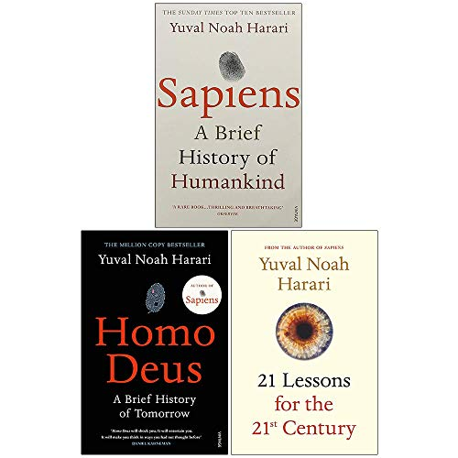
Yuval Noah Harari (2020)
The World after Coronavirus
Financial Times, 30th March, 2020
30-minute reading and note-taking

Slide 11
Questions
What kind of issues or ideas do Gates and Harari converge on? How do they differ from each other?
What kind of issues or ideas, do you think, are most crucial to the current global situation?

Slide 12

The Plague
Albert Camus (1913-1960)
Nobel Prize for Literature (1957)
An existential novel
The Plague.MOV

Slide 13
Quotes from the Plague
They considered themselves free and no one will ever be free as long as there is plague, pestilence and famine.
All I maintain is that on this earth there are pestilences and there are victims, and it’s up to us, so far as possible, not to join forces with the pestilences.

Slide 14
Quotes from the Plague
The evil that is in the world comes out of ignorance, and good intentions may do as much harm as malevolence, if they lack understanding.
All a man could win in the conflict between plague and life was knowledge and memories.
But what does it mean, the plague? It’s life, that’s all.

Slide 15
Quotes from the Plague
The whole thing is not about heroism, it’s about decency. It may seem a ridiculous idea, but the only way to fight the plague is with decency… in my case, it consists in doing my job.

Slide 16
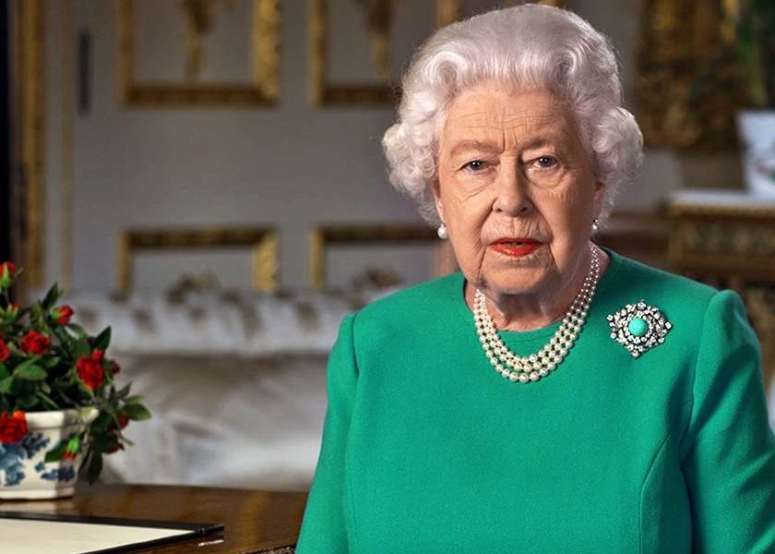
Queen Elizabeth II (1926-)
A rare televised address
Queen's speech 2020.mp4

Slide 17
The Queen’s Speech
Together we are tackling this disease, and I want to reassure you that if we remain united and resolute, then we will overcome it.
I hope in the years to come, everyone will be able to take pride in how they responded to this challenge.
The attributes of self-disciple and quiet good-humored resolve, and a fellow feeling still characterize this country.

Slide 18
The Queen’s Speech
The pride in who we are is not a part of our past, it defines our present and our future.
Self-isolation… presents an opportunity to slow down, pause and reflect, in prayer or meditation.
We will be with our friends again; we will be with our families again; WE WILL MEET AGAIN.

Slide 19
Homework
Extensive reading:
→ Different opinions about the current crisis
→ Historical, literary and philosophical works on the theme of epidemic in human history in general

Slide 20
Homework
Reflection:
→ What kind of message or issue emerged from your previous feature article?
→ What do other people think about the issue? What do you think about it?

